Slide 1
Waupun Police Department 2022 Annual Report

Slide 2
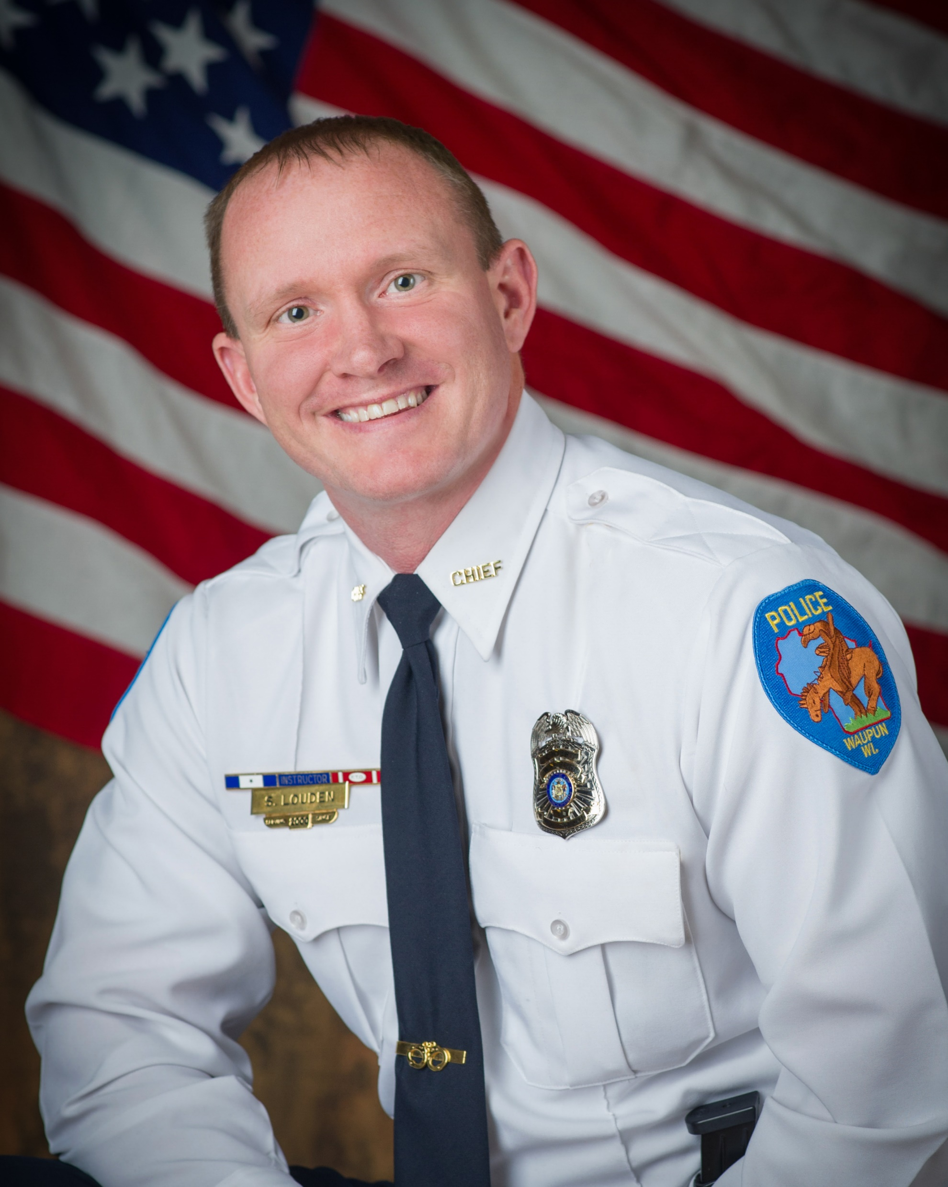
Message From Chief Scott Louden
As Chief our Department would to thank our community for their continuous and generous support. The department was able to participate with in person community events such as; the Bicycle Rodeo, Halloween on Main, Shop w/a Cop, Breakfast w/Santa, Senior Citizen Police Academy and other parades and celebrations throughout the year. The city of Waupun continues to remain a very safe place to reside as we were ranked as the 15th safest city in Wisconsin in 2022. We are committed to providing a safe environment so that citizens and visitors can work, live, and enjoy a high quality of life. I’d like to personally thank all of the members of the police department for their hard work and dedication to this community. See you in 2023!
Chief Scott Louden

Slide 3
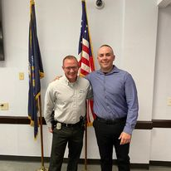
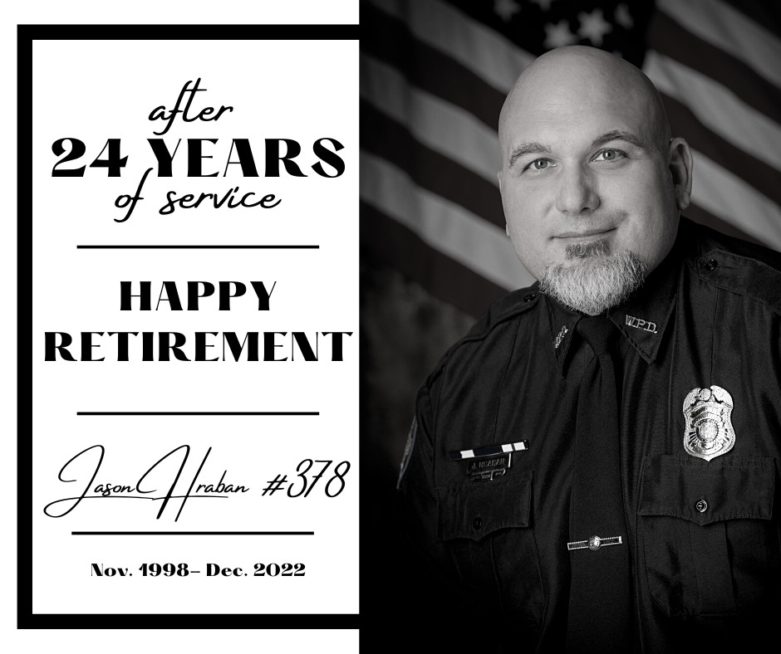
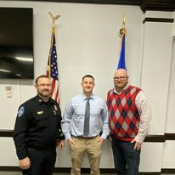
New Hires
Officer Alex Warner was hired in May 2022, successfully complete the police recruit academy, and is currently field training. (pictured left w/Chief Louden)
Officer Jaret Knudson was hired in December 2022 and is currently in field training. (pictured left with Deputy Chief Rasch and Mayor Bishop)
Departures
Officer Jason Hraban retired after 24 years of service to the city of Waupun.
Officer Nicholas Kearns took a sheriff’s deputy position with the Columbia County Sheriff’s Office after 1 year of service to the City of Waupun.

Slide 4
Department Roster
Administration Serving Since
Chief Scott Louden 04/12/2000
Deputy Chief Jeremy Rasch 01/16/2002
Admin Assistant Dawn Greenfield 10/14/2013
Records Clerk Danyelle DeBoer 01/21/2019
Patrol Lieutenant Joe Pfalzgraf 07/31/2000
Patrol Lieutenant Brad Brzezinski 06/10/2003
Patrol Lieutenant Robert Williams 12/21/2014
Investigations Lieutenant Ted Sullivan 12/02/2019
Officers Serving Since
Patrol Officer Mike Navis 10/18/2002
Patrol Officer Trevor Kreitzman 01/08/2004
Patrol Officer Andrew Halverson (K9) 11/04/2016
Patrol Officer Ali Tipton 10/23/2017
Patrol Officer Annie Cedarquist 07/24/2018
Patrol Officer Graham Dumke 12/21/2020
Patrol Officer Aaron Gile 10/18/2021
Patrol Officer Jackson Hague 11/08/2021
Patrol Officer Alex Warner 05/23/2022
Patrol Officer Jaret Knudson 12/13/2022
Chaplains Serving Since
Pastor Doug Shotsky 05/26/2020
Pastor William Gould 04/22/2022

Slide 5
What’s New at the PD Waupun Safest City In Wisconsin Ranking Ranked #15 by Safewise Body Cameras Waupun PD implemented the policy and the use of body cameras in 2022. Emergency Management Institute Chief Louden, Deputy Chief Rasch, and Lt Joe Pflazgraf participated in the FEMA training that brought numerous agencies from throughout the both Dodge and Fond du Lac Counties and agencies from throughout the state of Wisconsin to the city of Waupun. Gregory Spittel Homicide Trial Spittel was convicted of 2nd Degree Homicide, Disorderly Conduct, Threats to Law Enforcement, Resisting an Officer, Possession of Cocaine, and Possession of Drug Paraphernalia. Active Shooter Incident Management This county wide (Fond du Lac) training program was implemented and training began in September. Officer Graham Dumke was certified to train the course. The goal is to have all first responders receive certification in this training. County wide training will continue in 2023.
Records Update (Motorola Spillman RMS/CAD project)
The county wide (Fond du Lac) records management system was switched over to Motorola Spillman in January 2022 which required a lot of extra tasks, learning, and updating throughout the year.
Waupun PD K9 Program
Officer Halverson was selected as WPD’s K9 Handler. K9 Jet was purchased from Jessiffany Canine Services. Officer Halverson and K9 Jet received certification as a K9 Team in October. Thanks to all who have donated to and supported the K9 program.
Senior Citizen Police Academy
This years academy was in person and again a success due to all of the willing participants. Thanks to Waupun Fire Dept and Lifestar EMS for also participating.
2022 Police and Fire Commission Members President Mike Thurmer Vice President John Bett Secretary Tara Rhodes Teresa Heidemann
Bambi Buchholz Nancy Vanderkin, Council Member – Ex Officio

Slide 6
2022 Department Awards Our annual department awards program was implemented in 2017 to formally recognize the outstanding efforts and accomplishments of our staff. Life Saving Award Officer Annie Cedarquist Officer Jackson Hague Officer Trevor Kreitzman Lieutenant Joe Pfalzgraf Commendation Award Administrative Assistant Dawn Greenfield Military Veteran Pin Officer Aaron Gile K9 Officer Pin Officer Andrew Halverson Training Instructor Pin Officer Graham Dumke Officer Annie Cedarquist Fond du Lac County Law Executive Board Life Saving Award Officer Trevor Kreitzman Officer AJ Halverson Lieutenant Joe Pfalzgraf Dodge County Law Executive Board Support Person of the Year Administrative Assistant Dawn Greenfield

Slide 7
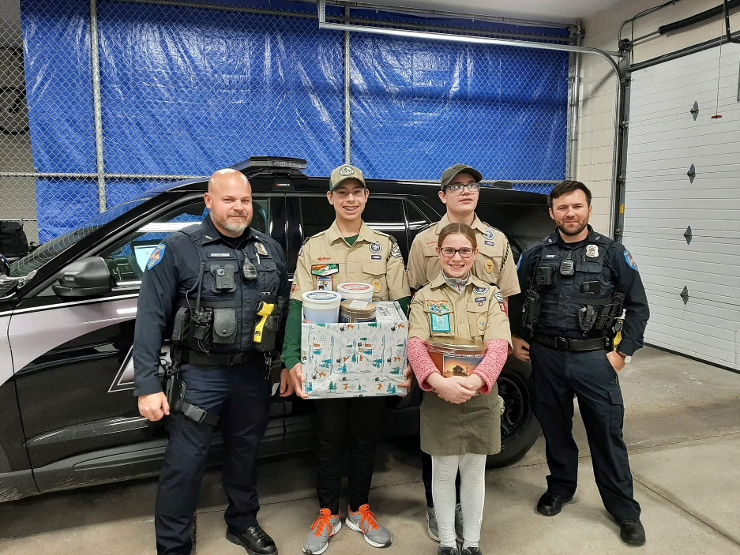
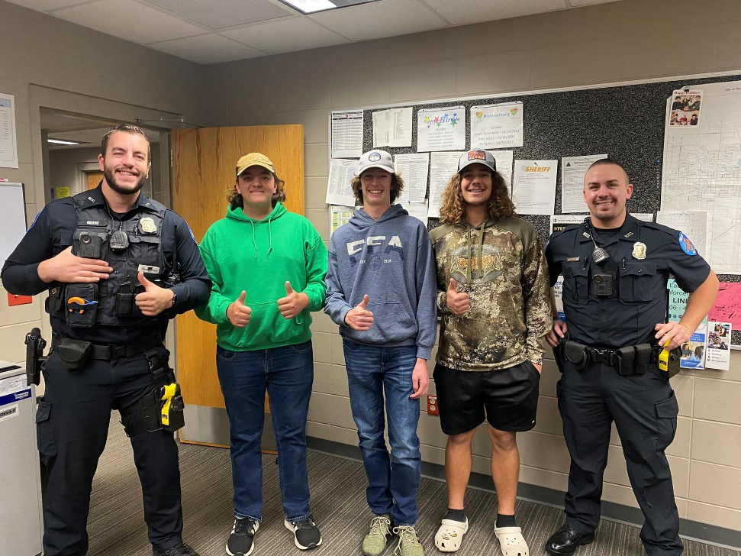
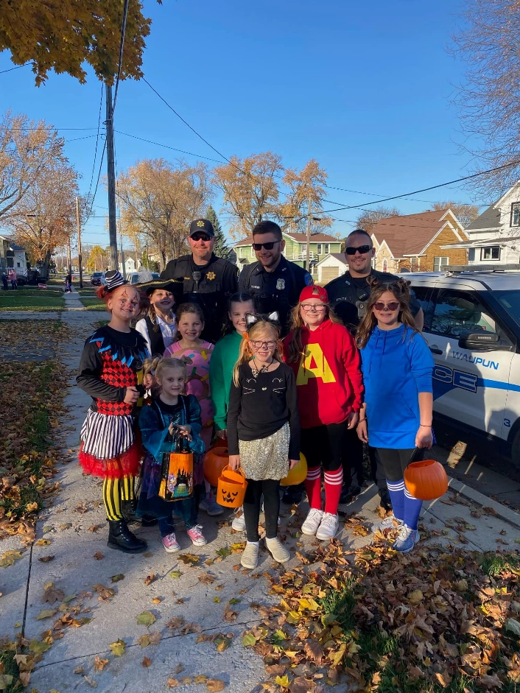
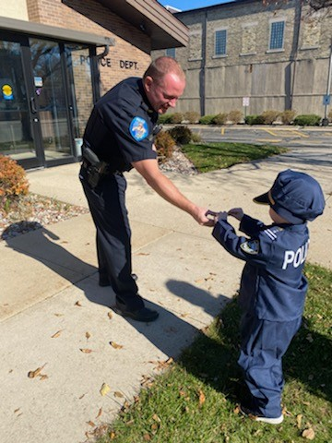
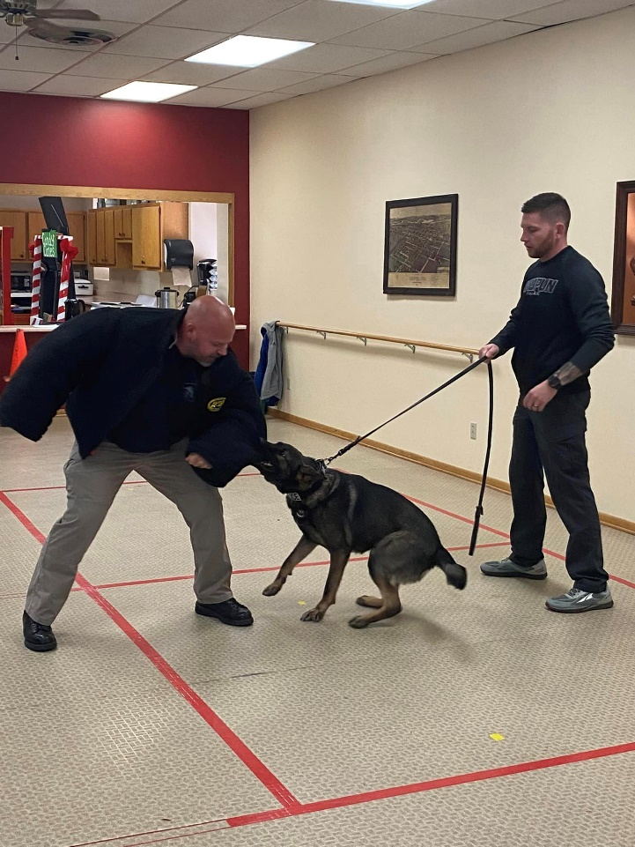
Officers and Community
Waupun Local Scouts share some tasty treat with officers. (Pictured: Officer Kreitzman and Officer Dumke)
Waupun FFA sharing some treats and drinks with officers. (Pictured: Officer Hague and Officer Warner)
Chief Louden hands out some candy during Trick or Treating to a future police officer.
Officer Halverson and Officer Warner handing out candy and pose for a photo with some great kids during Trick or Treating.
K9 Jet directed by K9 Officer Halverson to bite Officer Kreitzman during a demo at the Waupun Senior Citizen Academy.

Slide 8
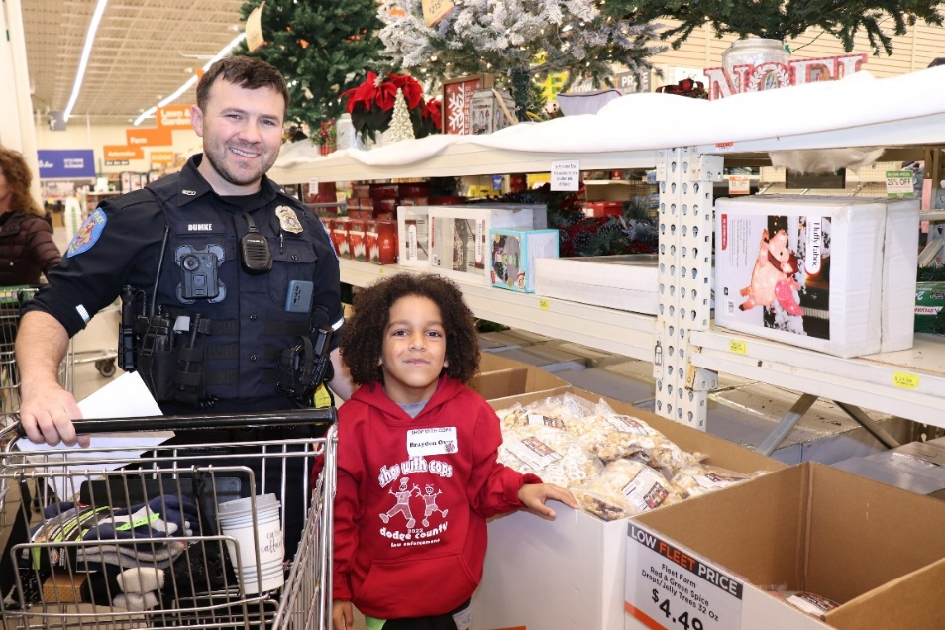
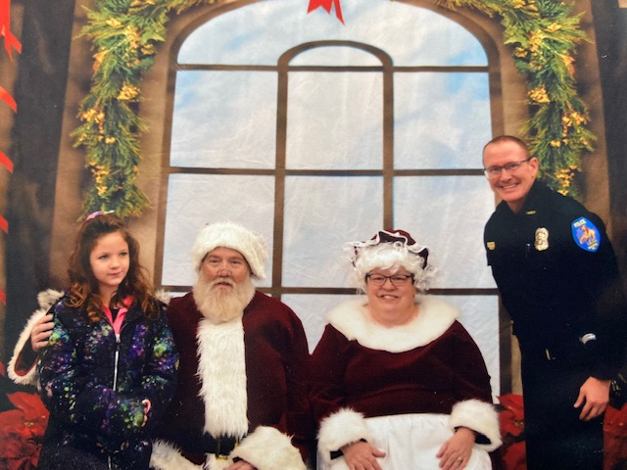
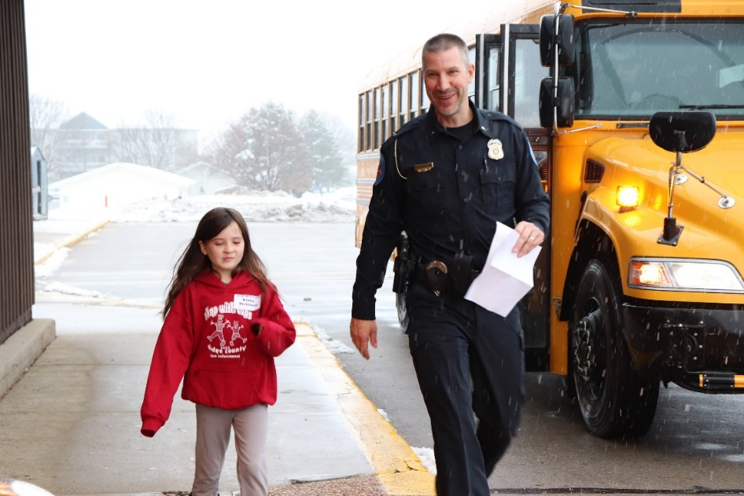
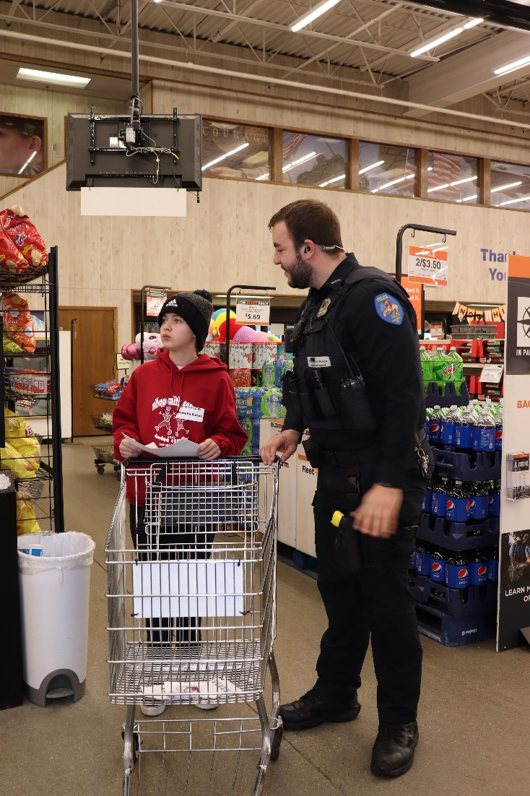
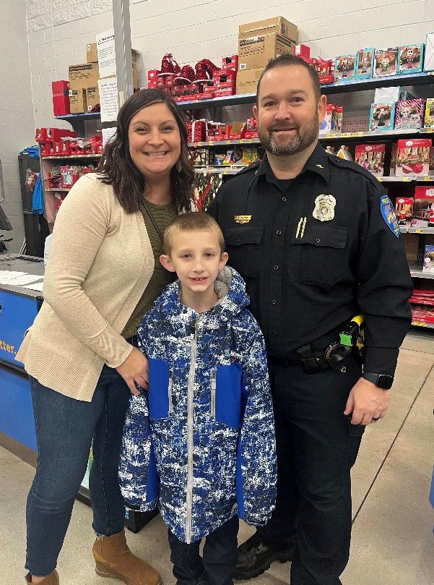
Officers and Community
Officer Dumke at Dodge County Shop w/a Cop
Chief Louden at Fond du Lac County Shop w/a Cop
Officer Hague at Dodge County Shop w/a Cop
Lieutenant Sullivan at Dodge County Shop w/a Cop
Deputy Chief Rasch at Fond du Lac County Shop w/a Cop

Slide 9
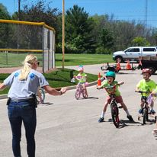
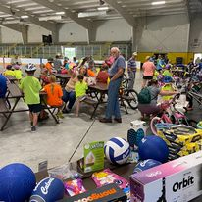
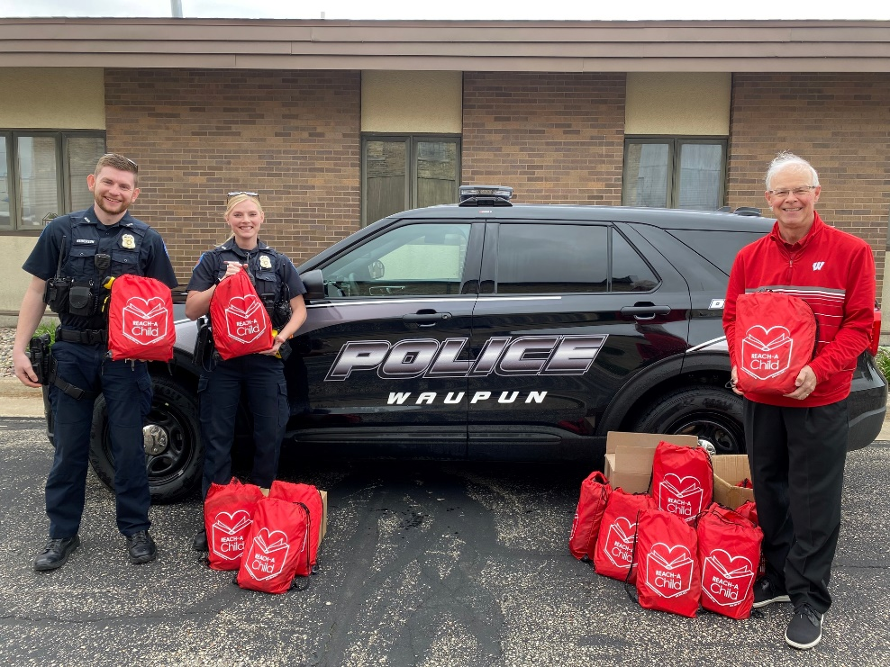
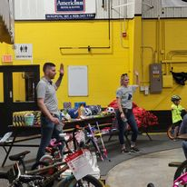
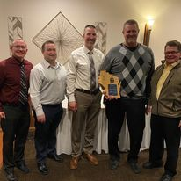
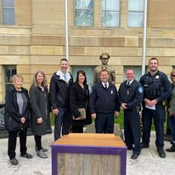
Officers and Community
WPD Staff working the annual bicycle rodeo. Many area businesses and organizations again donated prizes to make this a successful event. Thanks to Officer Halverson and Officer Tipton for organizing this event.
Officer Halverson and Officer Tipton receive books from Reach A Child to hand out at the annual bicycle rodeo.
Steve Smits was nominated by Waupun PD for the 2021 Dodge County Citizen of the Year. Steve received the award for going above and beyond assisting WPD with an ongoing investigation. (Pictured: Chief Louden, Deputy Chief Rasch, Lt Sullivan, Steve Smits, Retired Chief Tom Winscher)
Nancy Vanderkin PFC, Tara Rhodes PFC, Lt Sullivan, Admin Assist Dawn Greenfield, Deputy Chief Rasch, Chief Louden, and Officer Hague attending the 2022 Dodge County Law Enforcement Memorial event.

Slide 10
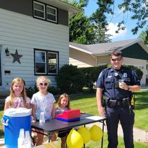
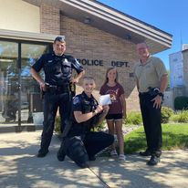
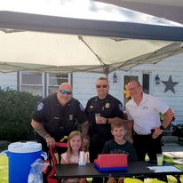
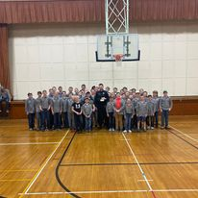
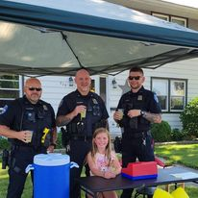
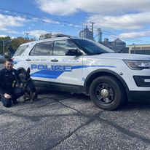
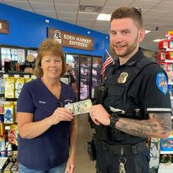
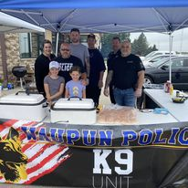
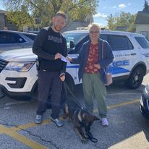
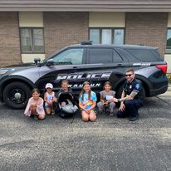
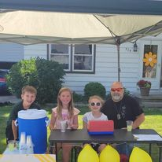
WPD K9 Program
Thanks to all of the officers, citizens, businesses, and other organizations for helping to fund our K9 Program. This program would not be possible if the entire community didn’t work together.
Officer Halverson and K9 Jet were selected to carry on the long tradition of K9 teams at the Waupun Police Dept.

Slide 11
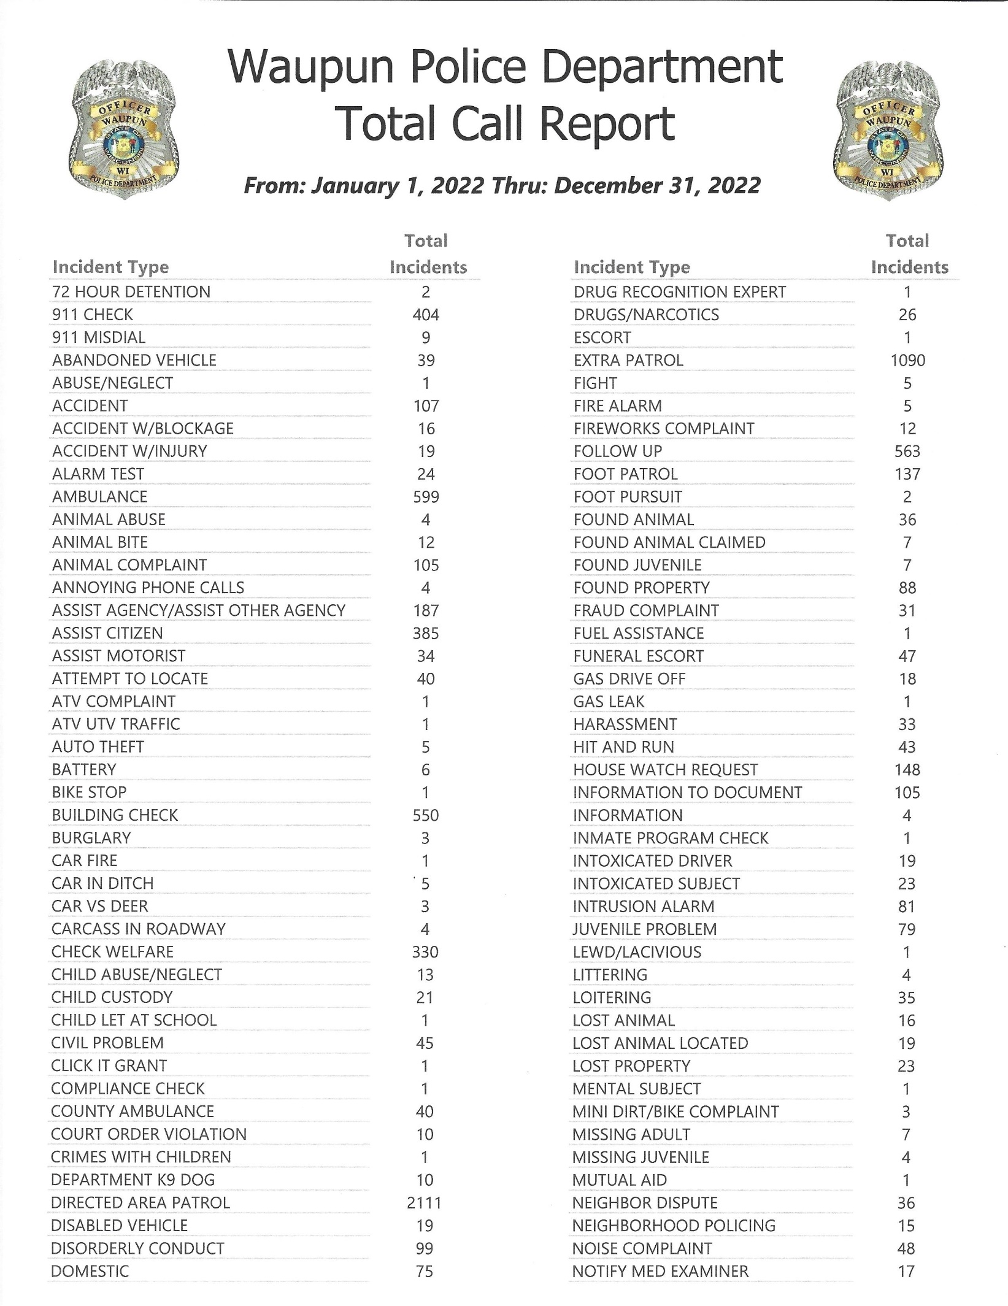
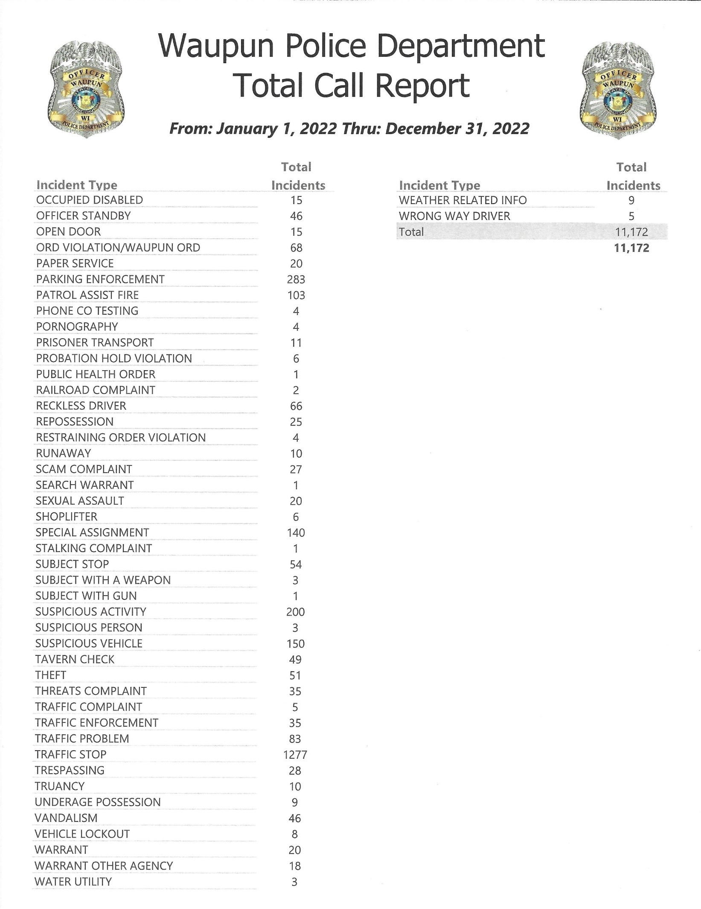

Slide 12
